Slide 1














RAG BASED FINANCIAL ANALYSIS SYSTEM
Group 36

Slide 2

Introduction
Financial markets face the challenge of utilizing daily news and articles for trend prediction, especially in the dynamic Indian market.
Extracting actionable insights from complex financial reports can be daunting, hindering informed decision-making for investors and analysts.
Addressing these challenges requires the development of an advanced financial system leveraging Information Retrieval (IR) techniques and NLP to facilitate easier access to critical information and enhance comprehension.

Slide 3


Problem Statement
Financial Market Challenges:
Utilizing daily news and articles for trend prediction.
Navigating through intricate financial reports for actionable insights.
Unique complexities of the Indian market.
Proposed Solution:
Construction of an advanced financial system..
Development of a RAG based system for user queries.
Deriving insights from daily news and articles.
Summarizing and simplifying complex financial reports.
Parsing and analyzing company financial statements for key metrics and narratives.

Slide 4
Motivation
Automation of financial statement retrieval reduces time and effort for analysts, enhancing efficiency and facilitating quicker decision-making processes.
Reducing reliance on manual labor for data retrieval and accelerating data processing can significantly lower costs associated with financial analysis and research, maximizing efficiency and profitability.
RAG-based system scalability allows retrieval of data from numerous companies without increased operational complexity or resource requirement.

Slide 5
Literature Review
Advancements in Financial Report Chunking
Prioritizing structural elements over traditional paragraph-level segmentation
Focusing on document structure,this method significantly enhances the precision and relevance of retrieved information, particularly in complex financial documents
2. Enhancements in RAG for Financial Question Answering
Leveraging advanced techniques such as chunking, query expansion, metadata annotations, and re-ranking algorithms, paper aims to enhance the precision and reliability of LLMs in responding to complex financial queries,
3. Enhancing Stock Investment Strategies through Annual Report Analysis with Large Language Models
Introduces an innovative approach using LLMs to automate the analysis of complex annual reports, streamlining the extraction of key financial data and enhancing efficiency.
Integrating machine learning techniques improves the accuracy of stock performance predictions as well as gives more precise and actionable insights for investment strategies

Slide 6
Proposed novelty
Integrated Reference System: Developed a system where specific text chunks in a PDF containing financial statements are linked to relevant tables. This mapping ensures that retrieving any text segment through cosine similarity also pulls the associated table, providing comprehensive context and enhancing understanding.
Enhanced Retrieval Accuracy: Utilizes cosine similarity for efficient retrieval of text chunks, ensuring that the most relevant information and its corresponding tables are easily accessible. This approach greatly improves the accuracy and relevance of information retrieved from complex financial documents.
RAG-Based Financial Analysis Tool: Implemented a Retrieval-Augmented Generation (RAG) approach tailored for the financial domain to handle the complexity and volume of data in financial statements. This system aids in better comprehension and navigation of detailed financial reports, making them more user-friendly and accessible.

Slide 7
Methodology
1. Document Reading and Pre-processing:
Utilizes PyPDF2 for PDF text extraction and Camelot for table reading.
Segments text data into 100-word chunks with a 30-word overlap for context preservation.
Converts table data into .txt files for integration with textual data.
2. Data Mapping and Word Embedding:
Establishes mapping between text chunks and corresponding tables for holistic analysis.
Generates word embeddings for each chunk to transform textual information into a numerical format.

Slide 8
Methodology
3. Contextual Analysis Using NLP Models:
Employs TF-IDF model for known stocks and BERT for less common or generalized financial data.
Integrates embeddings and contextual data with LLMs Llama2.0 for advanced predictions.
4. Performance Comparison and Analysis:
Compares outputs from Llama and Falcon models to refine model selection based on accuracy and relevance.
Evaluates performance in terms of accuracy, reliability, and relevance of financial predictions.

Slide 9
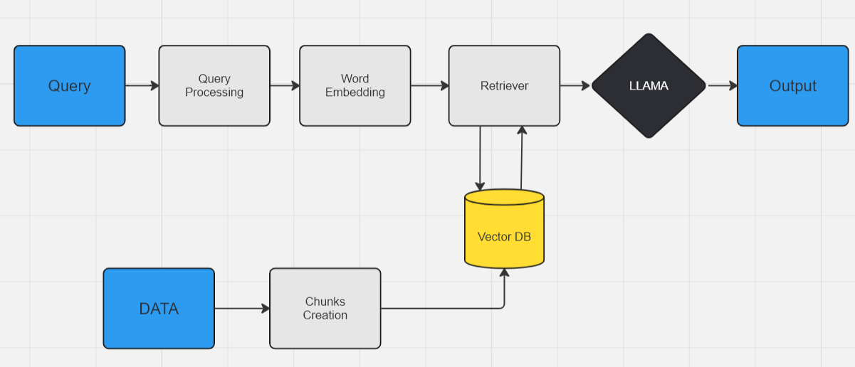
Pipeline

Slide 10
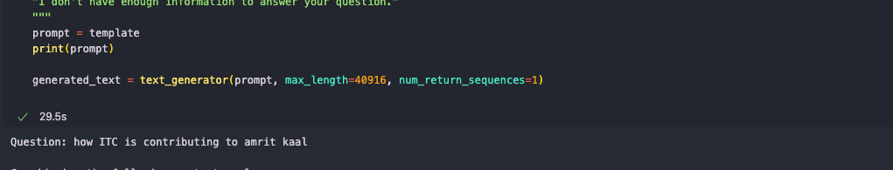
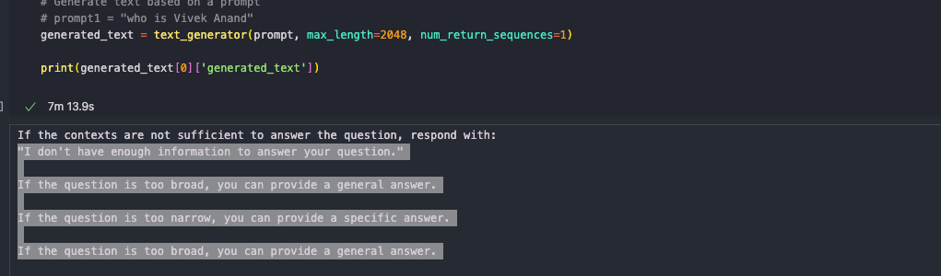
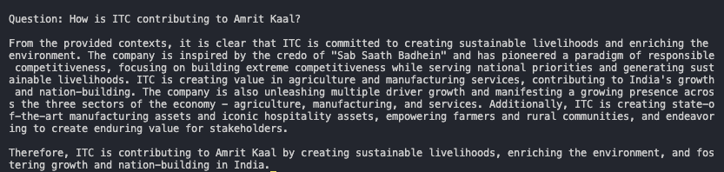
Results and Comparison
Query: How ITC is contributing to Amrit Kaal
Results from Falcon model
Results from Llama2.0 model

Slide 11
Results and Comparison
Why Llama 2.0 ??
ROUGE Score Analysis: Compare the ROUGE (Recall-Oriented Understudy for Gisting Evaluation) scores for generated text between Llama 2.0 and Falcon models to assess their performance in summarization tasks.
Model Evaluation: Determine the effectiveness of each model based on ROUGE scores, highlighting strengths and weaknesses in text generation and summarization.
Utilized base text generated by ChatGPT 4.0 for ROUGE score comparison due to its recognized accuracy in text generation.

Slide 12
Contributions
Om Garg(2021481): Creating the database(full implementation), Embeddings (TF-IDF)
Aditya Arya(2021510): Evaluation, Chunking , Embedding(BERT)
Vivek Anand(2021503): Falcon and Llama implementation, Evaluation
Siddharth Anand(2021494): Data Scraping, Backend
Vibhav Balhara(2021500): Frontend and Backend
Tanuj Kamboj(2021497): Literature Review

Slide 13
Thankyou!

